Slide 1
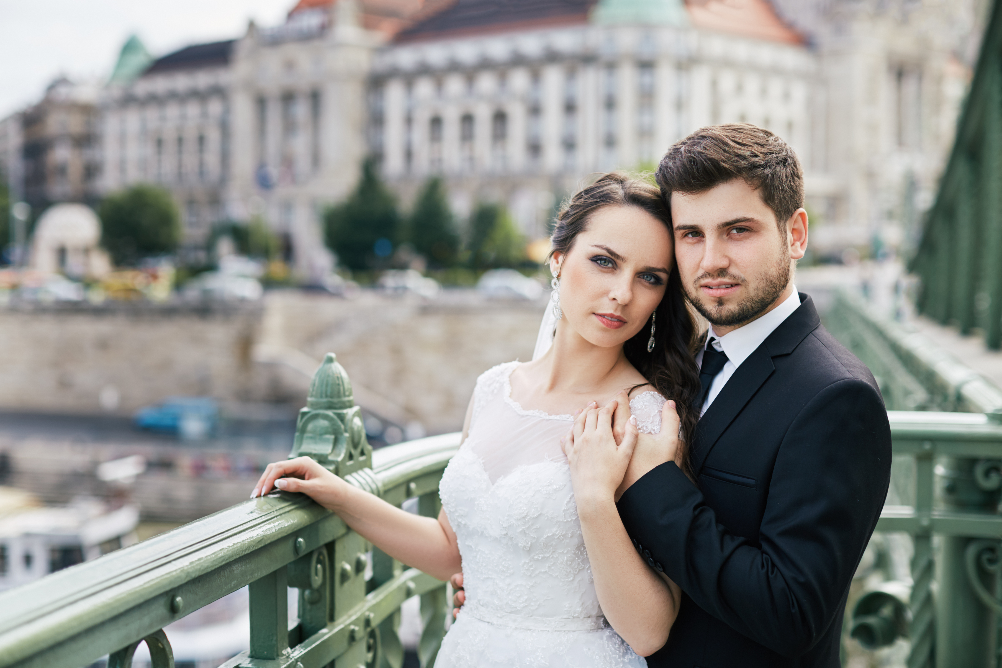
Welcome
TO THE WEDDING CEREMONY OF
OLIVIA WHITE
&
OLIVER BLACK
Thank you for celebrating with us

